Slide 1

Improving Acne Detection and Severity Grading Using Deep Learning on Smartphone Images
CS512 Fall 2024
Presented By:
Anayna Nidhi Singh, A20547310
Narasimha Karthik G, A20536058

Slide 2

Automatic Acne Object Detection and Acne Severity Grading Using Smartphone Images and AI
Primary Paper
Authors: Huynh, Q.T., Nguyen, P.H., et al.
Implementing a two-stage model combining:
Faster R-CNN (for acne object detection)
LightGBM machine learning model (for severity grading)
Diagram 1: Picture of a woman
with acne. Source: freepik.com

Slide 3
Problem Statement

Slide 4
Prevalence and Impact of Acne
Global Reach: Affects approximately 9.38% of the world’s population, impacting adolescents and adults alike.
Diverse Manifestations:
Inflammatory Lesions: Includes papules, pustules, and nodules.
Non-Inflammatory Lesions: Includes blackheads and whiteheads.
Health Consequences: Severe acne can lead to permanent scarring and significant psychological impacts, such as:
Anxiety
Low self-esteem

Slide 5
Current Limitations
Limits accessibility for those in remote or underserved areas
Creates delays for individuals seeking timely assessments.
Dependency on Specialists: Acne diagnosis and grading typically require a dermatologist, which

Slide 6
Solution Opportunity
Automated Detection and Grading:
Leverage Computer Vision to identify and grade acne severity from smartphone images.
Enables users to self-monitor and receive early intervention suggestions, fostering proactive acne management.
Impact: Increases accessibility, empowers patient engagement, and supports timely care

Slide 7
Proposed Solution
Two-Stage AI System:
Acne Object Detection Model: Detects different acne lesion types.
Acne Severity Grading Model: Uses detected lesions to assign a severity grade.

Slide 8
Proposed Solution
Acne Object Detection:
Model Architecture: Implemented using Faster R-CNN with a ResNet50 backbone.
Objective: Detects and classifies four acne types: blackheads/whiteheads, papules/pustules, nodules/cysts, and scars.
Training and Evaluation: Trained on the ACNE04 dataset with bounding box annotations. Performance measured via mean Average Precision (mAP).
Acne Severity Grading:
Model Architecture: LightGBM, utilizing output from the object detection model.
Objective: Grades acne severity on the Investigator's Global Assessment (IGA) scale, from 0 (clear) to 4 (severe).
Training and Evaluation: Assessed using metrics like accuracy and Area Under the ROC Curve (AUC).

Slide 9
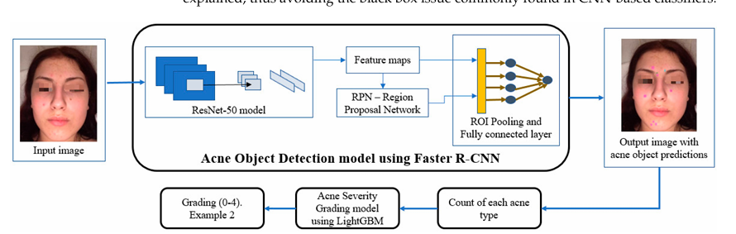
Proposed Solution
Diagram 2: Diagram of implementation of the R-CNN model for acne object detection to classify the types, then counting the number of each acne type and then implementing the LightGBM model for acne severity grading which grades acne from severity levels 0(low) to 4(high)

Slide 10
Advantages of this Solution
Mimics dermatologist assessments by considering lesion counts and types.
Uses smartphone images, enabling widespread accessibility.
Provides real-time analysis, allowing users to monitor and manage acne instantly without waiting for dermatologist appointments.

Slide 11
Dataset: ACNE04
Contains high-resolution images of faces with annotated acne types and severity grades.
Labeled for four acne types: blackheads/whiteheads, papules/pustules, nodules/cysts, and acne scars.
Severity labels follow the Investigator’s Global Assessment (IGA) scale, ranging from mild to severe.

Slide 12
Challenges and Solutions while Implementation
Data Imbalance: Augmented underrepresented severity grades to improve model accuracy across all grades.
Performance Optimization: Used GPU resources and dynamic learning rate adjustment to reduce training times.
Bounding Box Accuracy: Enhanced faint or low-contrast lesions like blackheads with targeted data augmentation and refined bounding box annotations.

Slide 13
Results: Object Detection

Slide 14
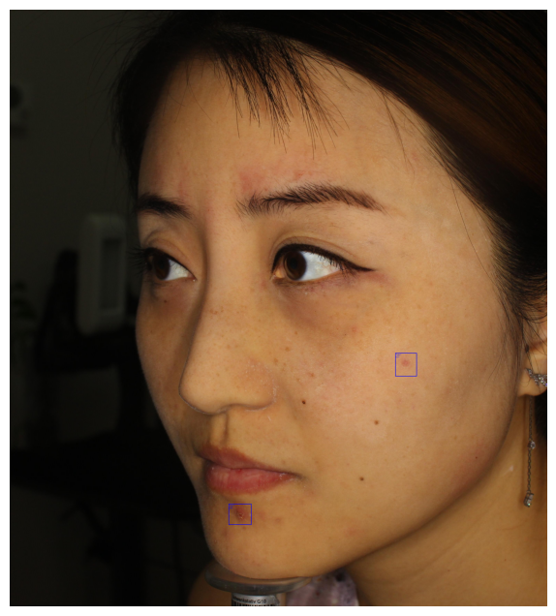
Results of evaluating R-CNN with Resnet-50 backbone for Object (Acne) Detection
Detection Summary:
Total detections after NMS: 2
Type 1: confidence = 0.8467
Type 1: confidence = 0.3067
Diagram 3: Results of evaluating R-CNN with Resnet-50 backbone for Object (Acne) Detection on sample image from ACNE04 dataset. Output generated from Python code.

Slide 15
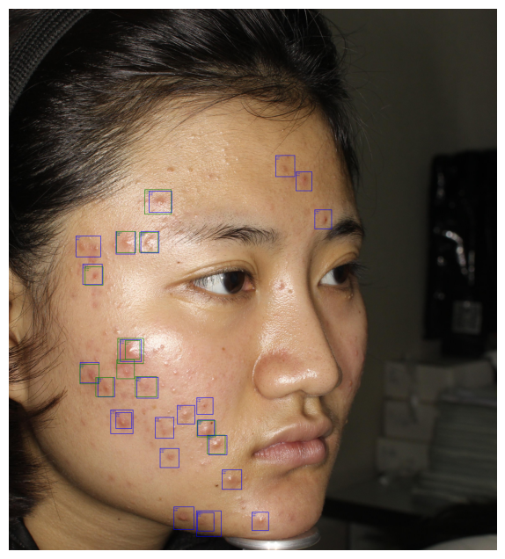
Results of evaluating R-CNN with Resnet-50 backbone for Object (Acne) Detection
Detection Summary:
Total detections after NMS: 37
Type 1: confidence = 0.8830
Type 1: confidence = 0.8609
Type 1: confidence = 0.8503
Type 1: confidence = 0.8386
Type 1: confidence = 0.8218
Type 1: confidence = 0.8210
Type 1: confidence = 0.7615
Type 1: confidence = 0.7403
Type 1: confidence = 0.7261
Type 1: confidence = 0.6845
Type 1: confidence = 0.6329
Type 1: confidence = 0.5848
Type 1: confidence = 0.4905
Type 1: confidence = 0.4489
Type 1: confidence = 0.3910
Type 1: confidence = 0.3773
Type 1: confidence = 0.3769
Type 1: confidence = 0.3671
Type 1: confidence = 0.3555
Type 1: confidence = 0.3391
Type 1: confidence = 0.3340
Type 1: confidence = 0.3281
Type 1: confidence = 0.3244
Type 1: confidence = 0.3049
Type 1: confidence = 0.3019
Type 2: confidence = 0.5490
Type 2: confidence = 0.4795
Type 2: confidence = 0.4662
Type 2: confidence = 0.4473
Type 2: confidence = 0.4357
Type 2: confidence = 0.4351
Type 2: confidence = 0.4349
Type 2: confidence = 0.4196
Type 2: confidence = 0.3354
Type 2: confidence = 0.3220
Type 2: confidence = 0.3219
Type 2: confidence = 0.3100
Diagram 4: Results of evaluating R-CNN with Resnet-50 backbone for Object (Acne) Detection on sample image from ACNE04 dataset. Output generated from Python code.

Slide 16
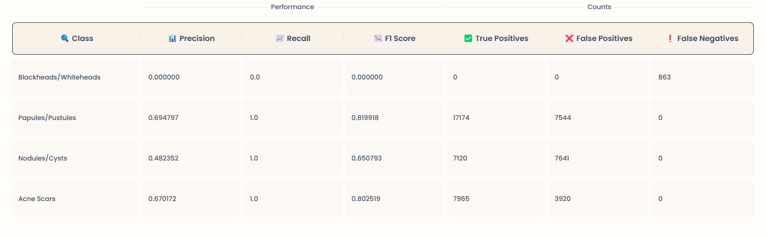
Metrics for Object Detection
Table 1: Table showing metrics for the object detection task using R-CNN with ResNet 50 backbone. Table values generated via Python code and formatted by MyLens.ai

Slide 17
Results: Severity
Grading

Slide 18
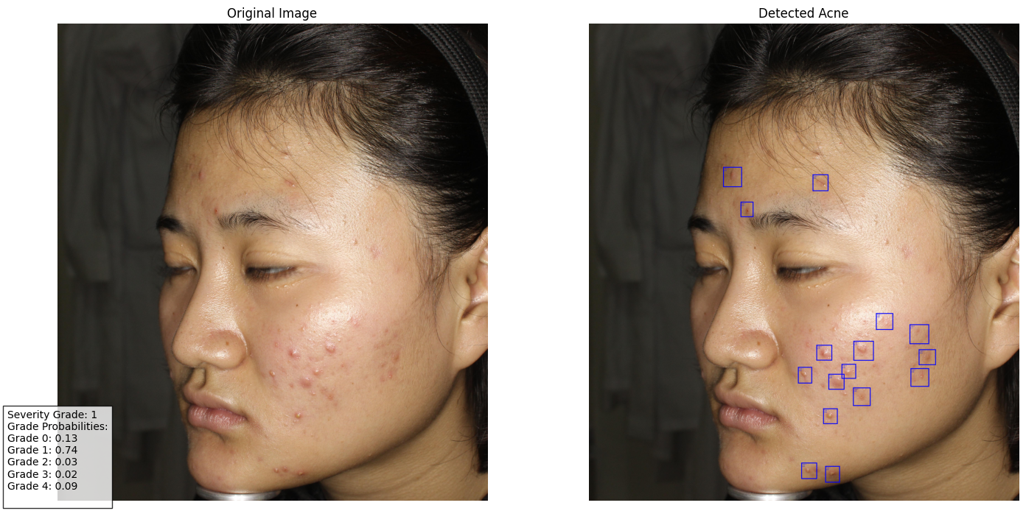
Results of evaluating LightGBM Model on Image for Severity Grading
Diagram 5: Results of evaluating LightGBM Model on sample image from ACNE04 dataset for Severity Grading. Output generated from Python code.

Slide 19
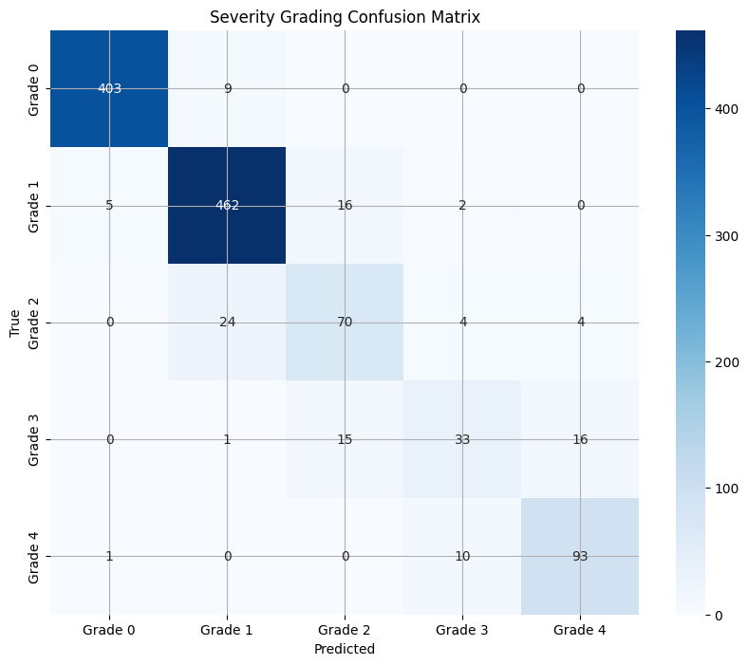
Severity Grading Confusion Matrix
Diagram 6: Confusion Matrix for Severity Grading generated by Python code

Slide 20
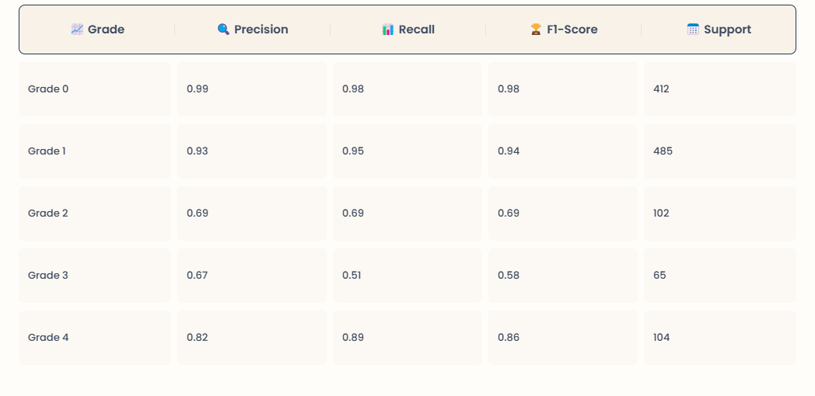
Classification report for Severity Grading
Table 2: Table values generated via Python code and formatted by MyLens.ai

Slide 21
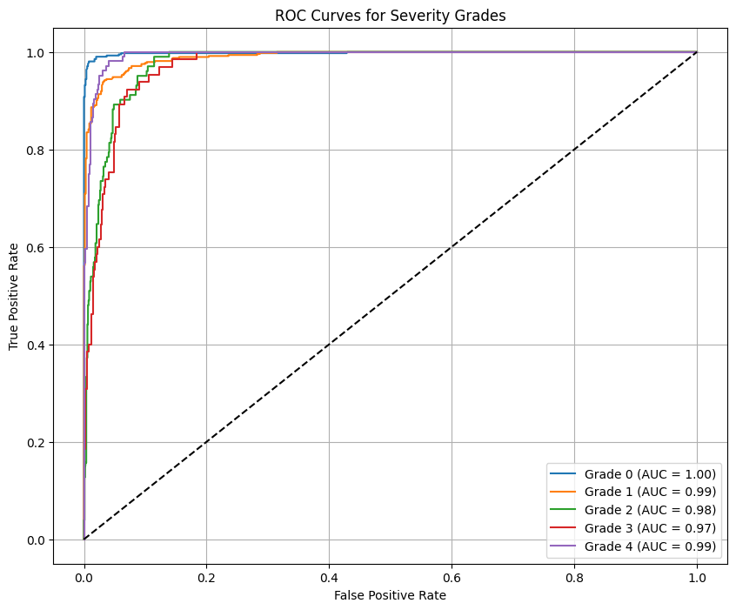
ROC Curves for Severity
Grading
Diagram 7: ROC curves for severity grading generated by python code

Slide 22
Evaluation Summary
Strengths
High interpretability with bounding box outputs, allowing clear visual inspection of detected lesions.
Weaknesses
Limited accuracy for faint lesions like scars, suggesting the need for further enhancements in data quality or model tuning.

Slide 23
Future Work
Improvements
Add more data to better represent rare acne lesions and severe cases.
Explore semi-supervised learning methods to enhance model performance with limited labeled data.
Potential Applications
Expand the model to detect and grade other skin conditions, such as rosacea or psoriasis, using similar techniques.

Slide 24
Demo Video

Slide 25
Thanks!
Do you have any questions?

